Slide 1
An Augmented and Virtual Reality System for Training Autistic Children
ISMAR 2014

Slide 2
INTRODUCTION
Autism Spectrum Disorder (ASD)
complex brain disorders
difficulty
social interaction
verbal and nonverbal communication
repetitive behaviors
technology devices rather than conventional training tools like pictograms
enjoyment, involvement, development of imagination and learning skills
AR/VR tools

Slide 3
INTRODUCTION
excel in music, math, art and visual skills
understand the skills they excel
require special attentive training.
Applied Behavior Analysis (ABA)
Principle
any correct behavior is more likely to be repeated if followed by some sort of reward
Discrete trial
(1) Instruct the task to the child
(2) Monitor the child response
(3) Reinforce the child action or prompt if necessary

Slide 4
INTRODUCTION
Discrete trial
(1) starts by showing a set of pictures (usually three) or real objects (Elephant toy for example) that child should learn/acquire
(2) associate a keyword with those picture or objects
(3) prompting or reinforcing based on their performed actions
(4) repeated several times by shuffling the pictures or objects and requesting them to show the keyword item
(5) along with the reward motivates the child
Discrete trial can be enhanced by using AR/VR technology

Slide 5
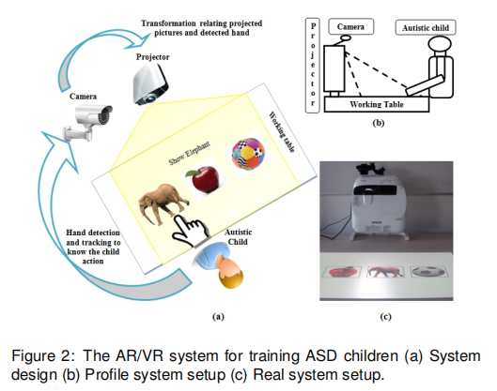
AUGMENTED AND VIRTUAL REALITY SYSTEM DESIGN
starts by displaying pictures or by placing objects and then instructs child to select one among them
action is monitored and the correct action is reinforced to motivate and encourage them to respond in the same way again
time out or wrong answer
records the child action and time

Slide 6
AUGMENTED AND VIRTUAL REALITY SYSTEM DESIGN
AR/VR system
User interface
ASD children do not like to attach fiducial markers or color gloves on their hands
remove or get distracted
unwanted hand movements to elude from answering the question
hand is considered as a major cue to detect their action
analyzing the hand trajectory information
Adaboost classifier
Calibration between camera and table
from camera or pixel coordinate system to the projector or table coordinate system
homography based transformation

Slide 7
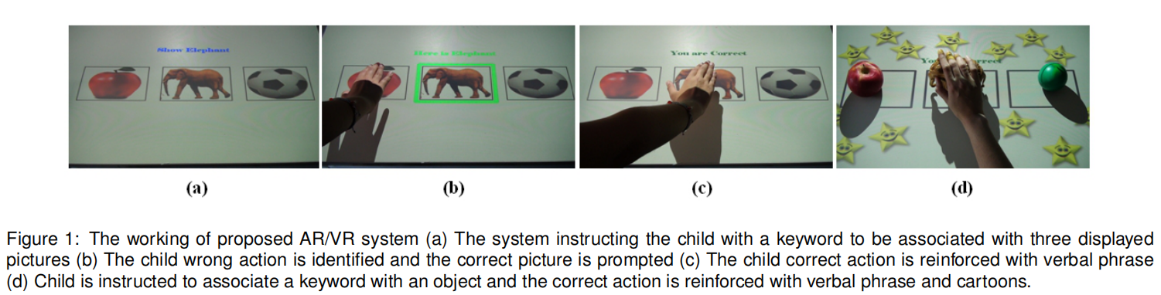
EXPERIMENTAL SETUP

Slide 8
SYSTEM EVALUATION AND OUTLOOK
Development
(1)Generic competencies
(2)Keyword and sentence association with a picture
(3)Identification and recognition capability
Future step
evaluate the system with ASD children to study on its usefulness in terms of interaction and learning
the proposed AR/VR system will be demonstrated to collect feedback from parents (in terms of usefulness to the child), teachers (to analyze on ease to teach the child or use the system) and psychologists (in the assessment of the child progress)

